Slide 1
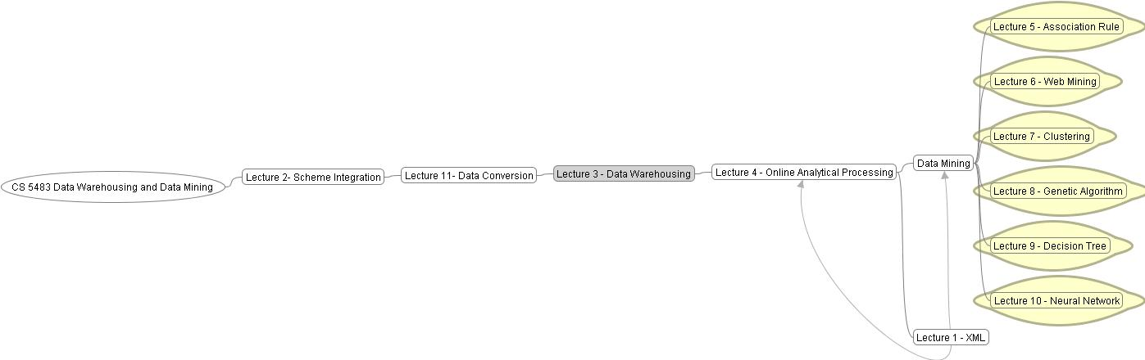
Data Warehousing and Data Mining

Slide 2
Why Data Mining? — Potential Applications
Database analysis and decision support
  Market analysis and management
    target marketing, customer relation management, market basket analysis, cross selling, market segmentation.
  Risk analysis and management
    Forecasting, customer retention, improved underwriting, quality control, competitive analysis.
  Fraud detection and management
Other Applications:
  Text mining (news group, email, documents) and Web analysis.
  Intelligent query answering

Slide 3
What Is Data Mining?
Data mining (knowledge discovery in databases):
  Extraction of interesting ( non-trivial, implicit, previously unknown and potentially useful) information from data in large databases
Alternative names and their “inside stories”:
  Data mining: a misnomer?
  Knowledge discovery in databases (KDD: SIGKDD), knowledge extraction, data archeology, data dredging, information harvesting, business intelligence, etc.
What is not data mining?
  (Deductive) query processing.
  Expert systems or small ML/statistical programs

Slide 4
Data Mining: A KDD Process
Knowledge
  Data mining: the core of knowledge discovery process.
Pattern Evaluation
Data Mining
Task-relevant Data
Data Warehouse
Selection
Data Cleaning
Data Integration
Databases

Slide 5
Data Mining: On What Kind of Data?
Relational databases
Data warehouses
Transactional databases
Advanced DB systems and information repositories
  Object-oriented and object-relational databases
  Spatial databases
  Time-series data and temporal data
  Text databases and multimedia databases
  Heterogeneous and legacy databases
  WWW

Slide 6
Data Mining Functionality
Association:
  From association, correlation, to causality.
  finding rules like “inside(x, city) → near(x, highway)”.
Cluster analysis:
  Group data to form new classes, e.g., cluster houses to find distributed patterns.
Decision Tree:
  Prioritize the important factors in constructing a business rule in a tree format.
Neural network:
  Prioritize the important factors in constructing a business rule in a weighting ranking.
Genetic Algorithm:
- The fitness of a rule is assessed by its classification accuracy on a set of training samples.
Web Mining:
- Data mining website for web usages analysis.

Slide 7
Knowledge Discovery Process
Data selection
Cleaning
Enrichment
Coding
Data Mining
Reporting

Slide 8
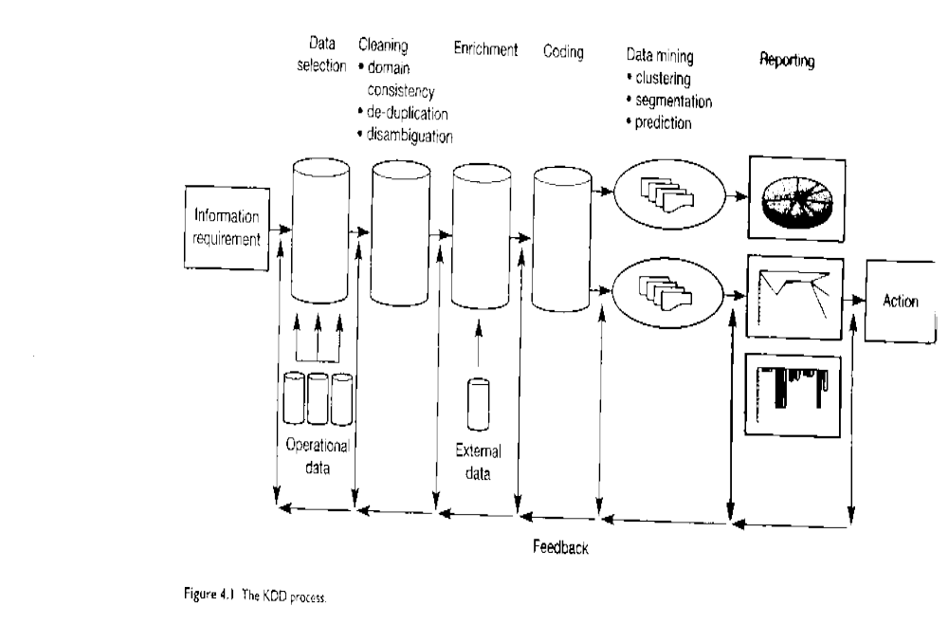

Slide 9
Data Selection
Once you have formulated your informational requirements, the nest logical step is to collect and select the data you need. Setting up a KDD activity is also a long term investment. A data environment will need to download from operational data on a regular basis, therefore investing in a data warehouse is an important aspect of the whole process.

Slide 10
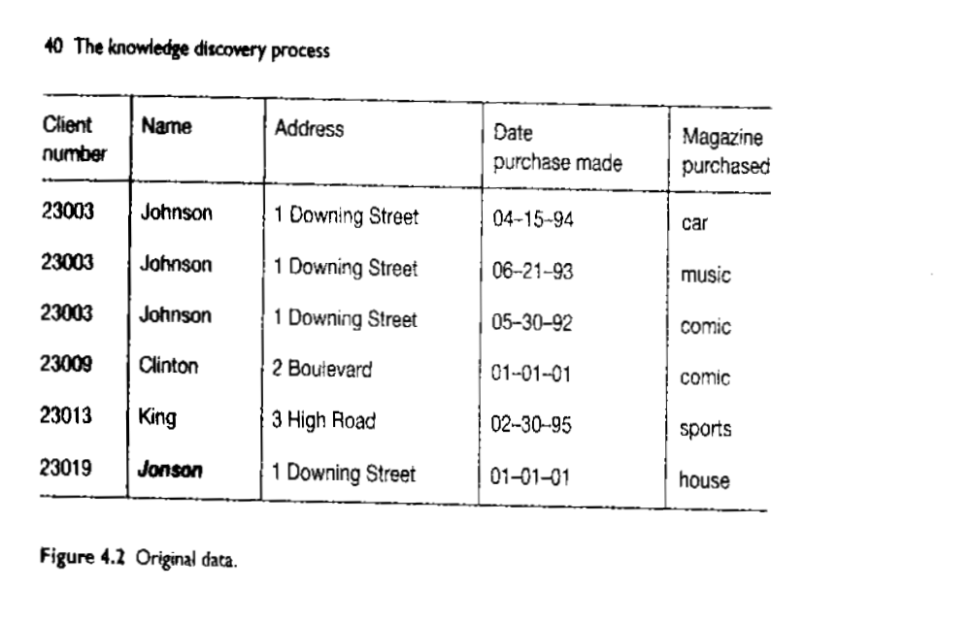

Slide 11
Cleaning
Almost all databases in large organizations are polluted and when we start to look at the data from a data mining perspective, ideas concerning consistency of data change. Therefore, before we start the data mining process, we have to clean up the data as much as possible, and this can be done automatically in many cases.

Slide 12
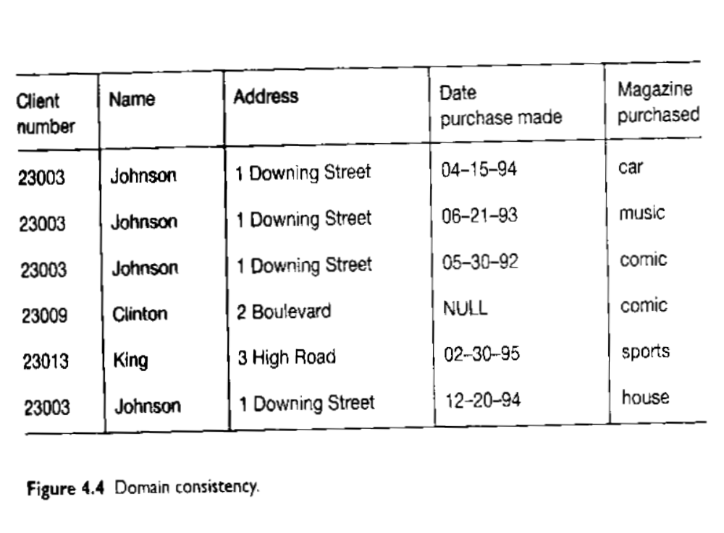

Slide 13
Enrichment
Matching the information from bought-in databases with your own databases can be difficult. A well-known problem is the reconstruction of family relationships in databases. In a relational environment, we can simply join this information with our original data.

Slide 14
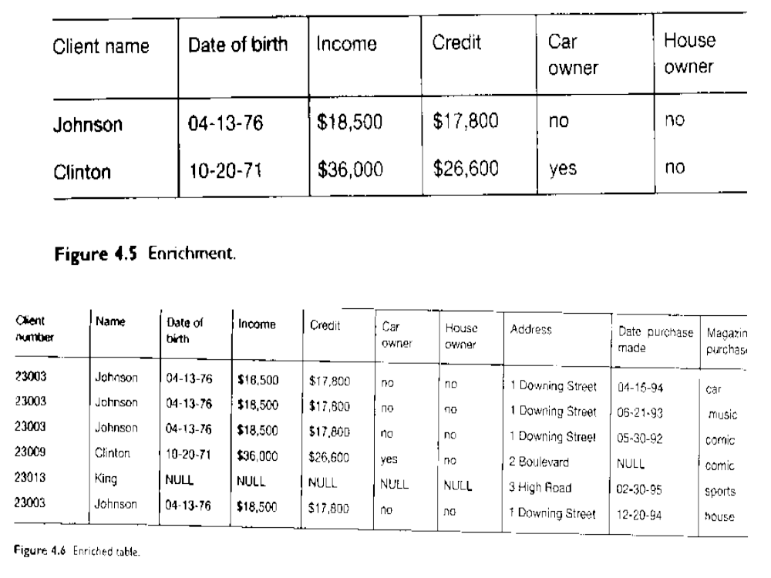

Slide 15
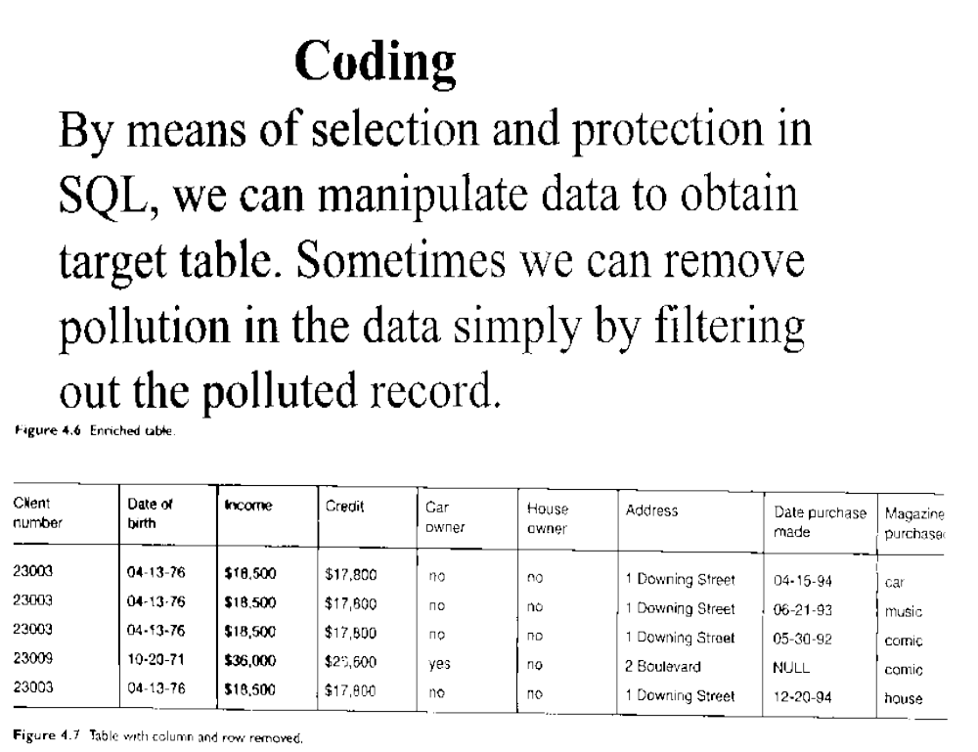

Slide 16
Technologies for Mining Frequent Patterns in Large Databases
What is frequent pattern mining?
Frequent pattern mining algorithms
  Apriori and its variations
Recent progress on efficient mining methods
  Mining frequent patterns without candidate generation

Slide 17
What Is Frequent Pattern Mining?
What is a frequent pattern?
  Pattern (set of items, sequence, etc.) that occurs together frequently in a database
Frequent pattern: an important form of regularity
  What products were often purchased together? — beers and diapers!
  What are the consequences of a hurricane?
  What is the next target after buying a PC?

Slide 18
Applications of Frequent Pattern Mining
Association analysis
  Basket data analysis, cross-marketing, catalog design, loss-leader analysis,
clustering
classification
  Association-based classification analysis
sequential pattern analysis
  Web log sequence, DNA analysis, etc.

Slide 19
Application Examples
Market Basket Analysis
  * ⇒ Maintenance Agreement
  What the store should do to boost Maintenance Agreement sales
  Home Electronics ⇒ *
  What other products should the store stocks up on if the store has a sale on Home Electronics
Attached mailing in direct marketing
Detecting “ping-pong”ing of patients
  transaction: patient
  item: doctor/clinic visited by a patient
  support of a rule: number of common patients

Slide 20
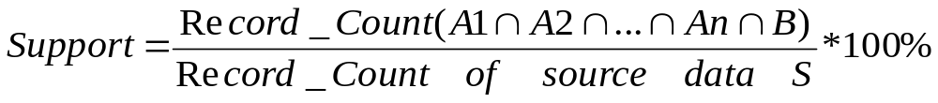
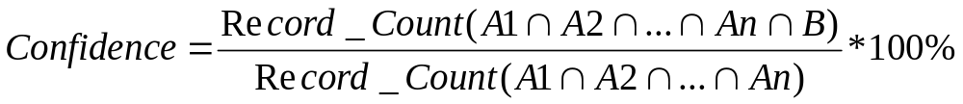
In general, given a count of source data S, an association rule indicates
that the events A1, A2,…An will most likely associate with the event B.
S = A1 + A2 + ….. + B + other events
A1, A2, ……An => B
The Support and Confidence level of this association is:

Slide 21
Association Rule Mining
Given
  A database of customer transactions
  Each transaction is a list of items (purchased by a customer in a visit)
Find all rules that correlate the presence of one set of items with that of another set of items
  Example: 98% of people who purchase tires and auto accessories also get automotive services done
  Any number of items in the consequent/antecedent of rule
  Possible to specify constraints on rules (e.g., find only rules involving Home Laundry Appliances).
  Association Rule:
  If people purchase tire and auto accessories
  Then people will also get automotive services done
  Confidence level: 98%

Slide 22
Basic Concepts
Rule form: “A → Β [support s, confidence c]”.
Support: usefulness of discovered rules
  Confidence: certainty of the detected association
  Rules that satisfy both min_sup and min_conf are called strong.
Examples:
  buys(x, “diapers”) → buys(x, “beers”) [0.5%, 60%]
  age(x, “30-34”) ^ income(x ,“42K-48K”) → buys(x, “high resolution TV”) [2%,60%]
  major(x, “CS”) ^ takes(x, “DB”) → grade(x, “A”) [1%, 75%]
  Association Rule:
  If Major = “CS” and takes “DB”
  Then Grade = “A”
  Support level = 1%
  Confidence level = 75%

Slide 23
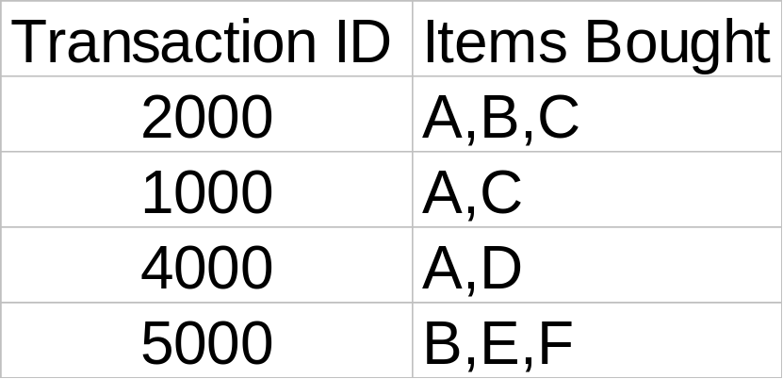
Rule Measures: Support and Confidence
Customer
buys both
Customer
buys diaper
Find all the rules X & Y ⇒ Z with minimum confidence and support
  support, s, probability that a transaction contains {X, Y, Z}
  confidence, c, conditional probability that a transaction having {X, Y} also contains Z.
Customer
buys beer
Let minimum support 50%, and minimum confidence 50%, we have
  A ⇒ C (50%, 66.6%)
  C ⇒ A (50%, 100%)

Slide 24
Frequent pattern mining methods: Apriori and its variations
The Apriori algorithm
Improvements of Apriori
Incremental, parallel, and distributed methods
Different measures in association mining

Slide 25
An Influential Mining Methodology — The Apriori Algorithm
The Apriori method:
  Proposed by Agrawal & Srikant 1994
  A similar level-wise algorithm by Mannila et al. 1994
Major idea:
  A subset of a frequent itemset must be frequent
    E.g., if {beer, diaper, nuts} is frequent, {beer, diaper} must be. Anyone is infrequent, its superset cannot be!
  A powerful, scalable candidate set pruning technique:
    It reduces candidate k-itemsets dramatically (for k > 2)

Slide 26
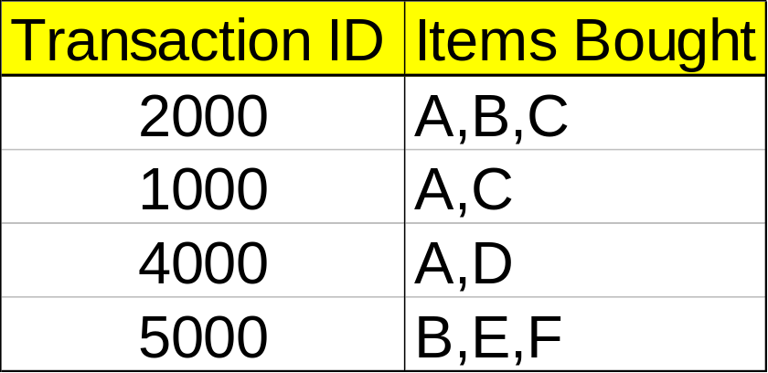
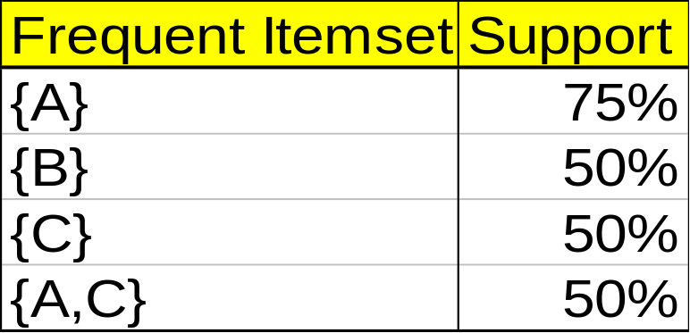
Mining Association Rules — Example
Min. support 50%
Min. confidence 50%
For rule A ⇒ C:
  support = support({A ∪C}) = 50%
  confidence = support({A ∪ C})/support({A}) = 66.6%
The Apriori principle:
  Any subset of a frequent itemset must be frequent.

Slide 27
Procedure of Mining Association Rules:
  Find the frequent itemsets: the sets of items that have minimum support (Apriori)
    A subset of a frequent itemset must also be a frequent itemset, i.e., if {A ∪ B} is a frequent itemset, both {A} and {B} should be a frequent itemset
    Iteratively find frequent itemsets with cardinality from 1 to k (k-itemset)
  Use the frequent itemsets to generate association rules.

Slide 28
The Apriori Algorithm
Join Step
Ck is generated by joining Lk-1 with itself
Prune Step
Any (k-1)-itemset that is not frequent cannot be a subset of a frequent k-itemset, hence should be removed.
(C_{k}: Candidate itemset of size k)
(L_{k} : frequent itemset of size k)

Slide 29
Apriori—Pseudocode
C_{k}: Candidate itemset of size k
L_{k} : frequent itemset of size k
L₁ = {frequent items};
for (k = 1; L_{k} !=∅; k++) do begin
C_{k+1} = candidates generated from L_{k};
for each transaction t in database do
  increment the count of all candidates in C_{k+1} that are contained in t
L_{k+1} = candidates in C_{k+1} with min_support
end
return ∪_{k} L_{k};

Slide 30








The Apriori Algorithm — Example
Database D
L₁
C₁
Scan D
C₂
C₂
L₂
Scan D
C₃
Scan D
L₃

Slide 31
Mining Frequent Itemsets without Candidate Generation
Apriori candidate generate-and-test method suffers from the following costs:
It may need to generate a huge number of candidate sets.
It may need to repeatedly scan the database and check a large set of candidates by pattern matching

Slide 32
Frequent-pattern growth(FP-growth)
It adopts a divide-and-conquer strategy to compress the database representing frequent items into a frequent-pattern tree (FP-tree).
The mining of the PF-tree starts from each frequent length-1 pattern (as an initial suffix pattern), construct its conditional pattern base (a “subdatabase” consisting of the set of prefix paths in the FP-tree), and then construct its (conditional) FP-tree.

Slide 33
Frequent Pattern Tree algorithm
Step 1: Create a table of candidate data items in descending order.
Step 2: Build the Frequent Pattern Tree according to each event of the candidate data items.
Step 3: Link the table with the tree.

Slide 34
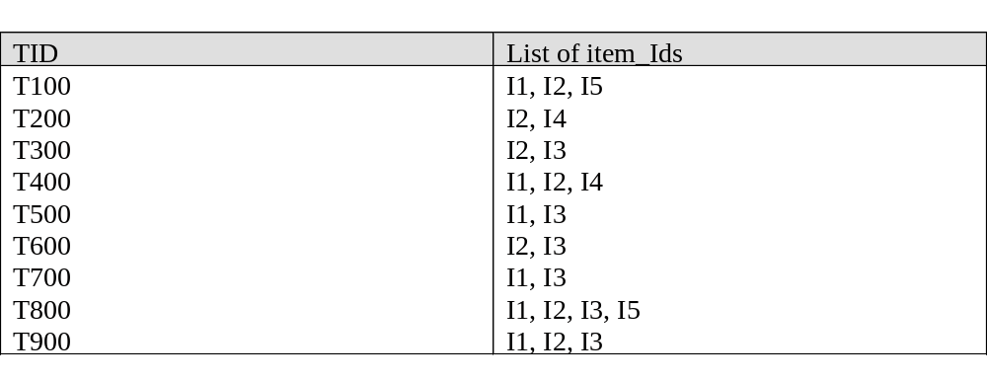
Transactional data for an AllElectronics branch

Slide 35
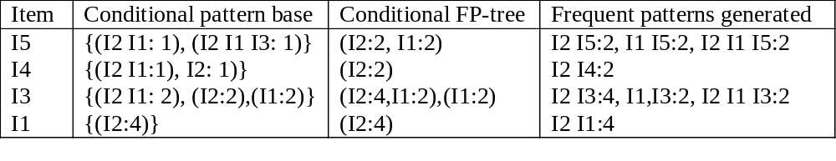
An FP-tree that registers compressed, frequent pattern information

Slide 36
Step 1 Get the frequent one item set in descending order with user requirement of Support Level = 2
I2 | 7
I1 | 6
I3 | 6
I4 | 2
I5 | 2

Slide 37
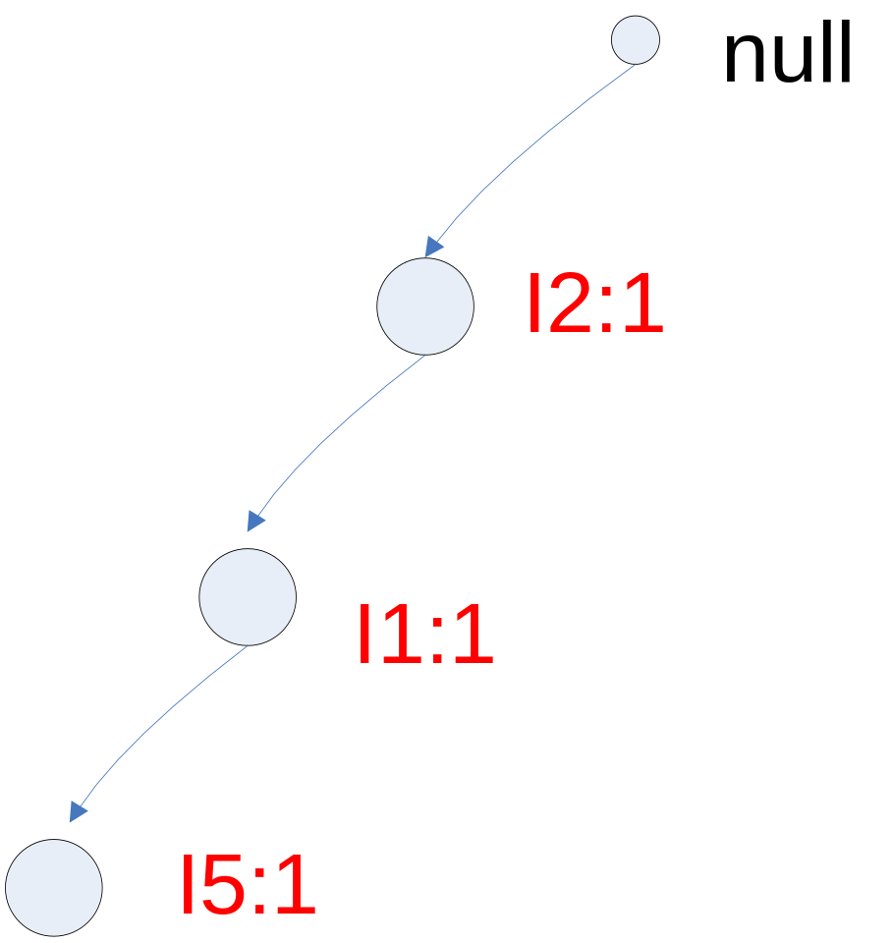
Step 2 T100=I2, I1, I5

Slide 38
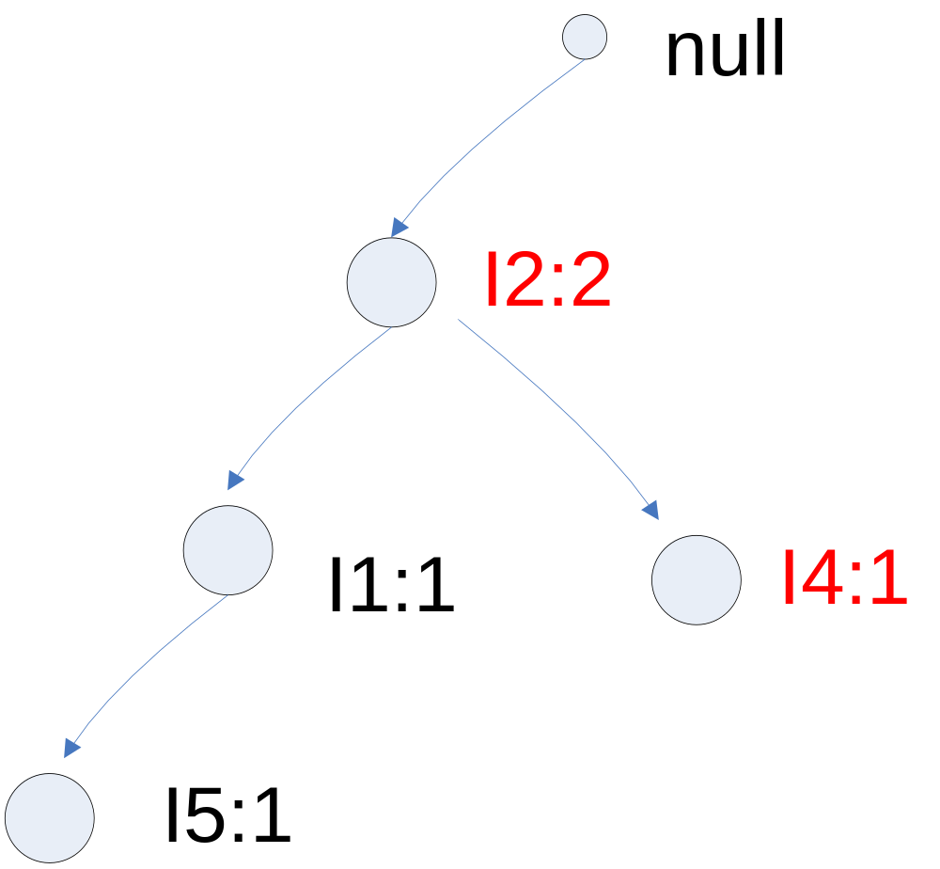
Step 3 T200=I2, I4

Slide 39
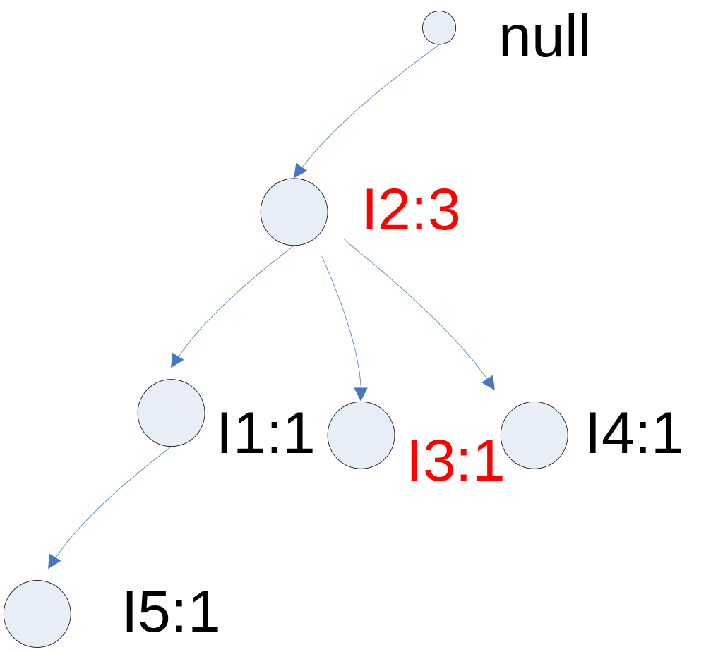
Step 4 T300=I2, I3

Slide 40
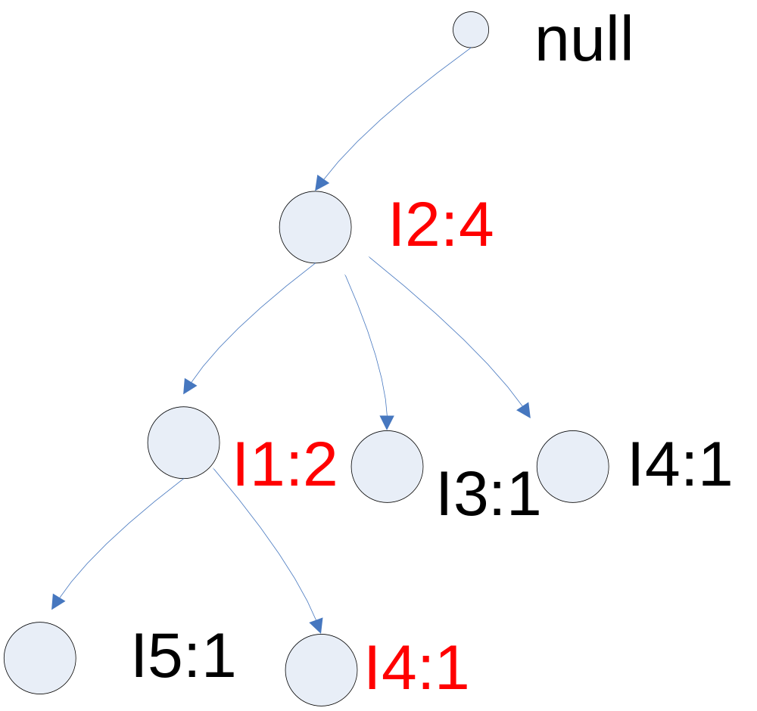
Step 5 T400=I1, I2, I4

Slide 41
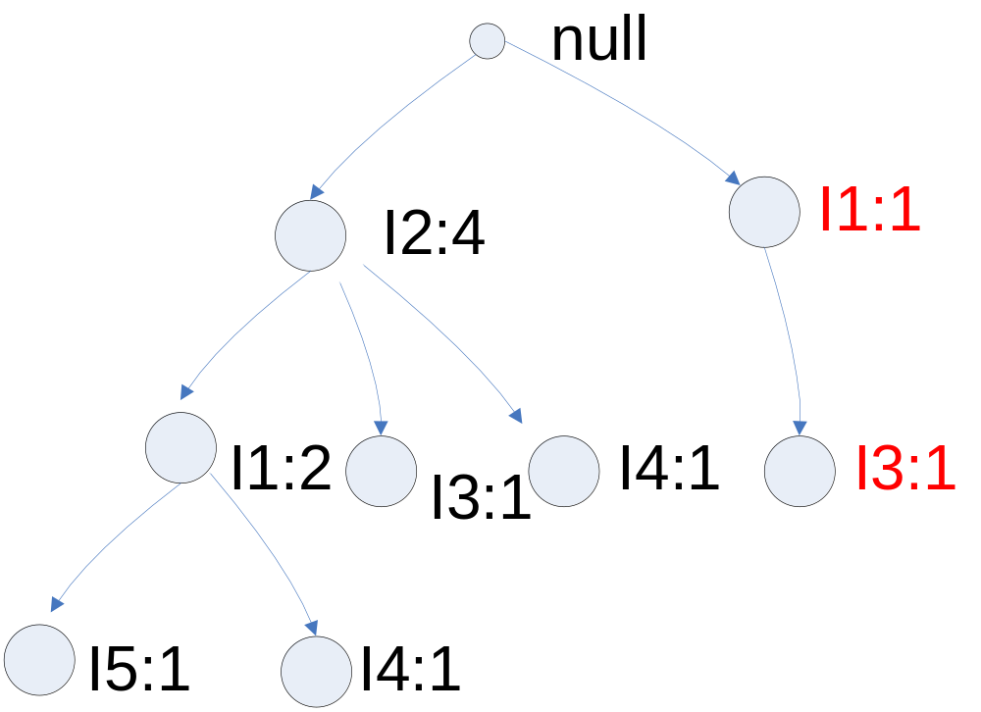
Step 6 T500=I1, I3

Slide 42
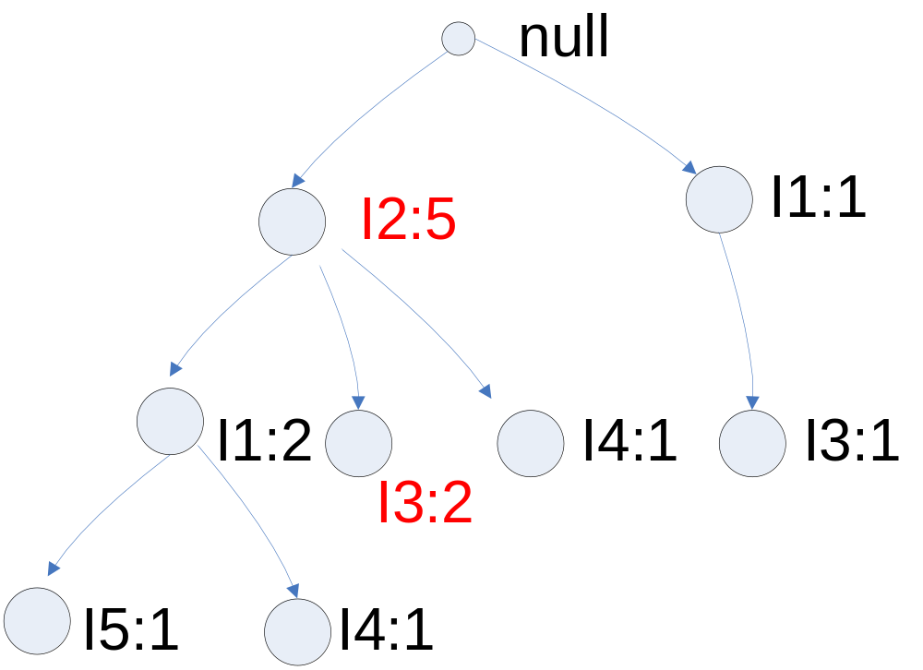
Step 7 T600=I2, I3

Slide 43
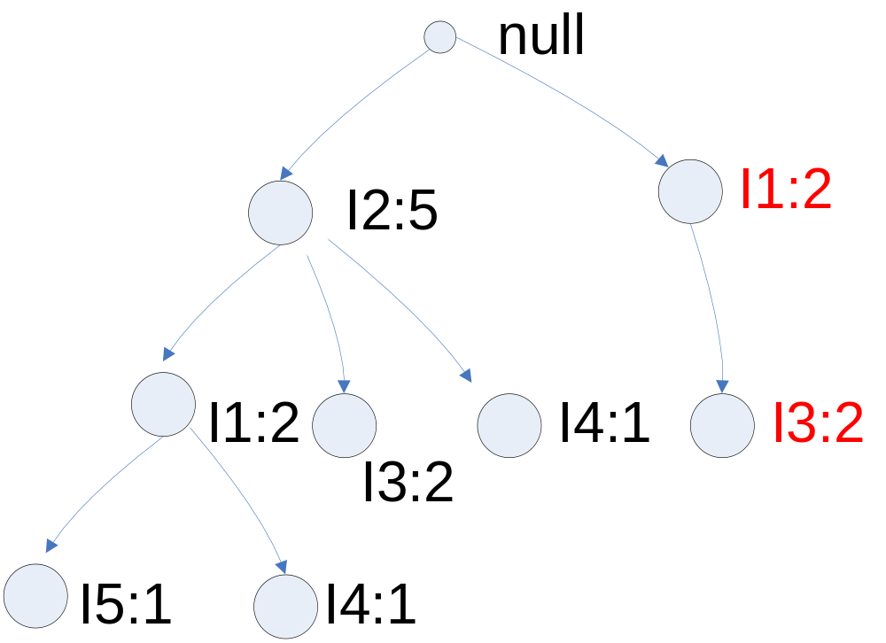
Step 8 T700=I1, I3

Slide 44
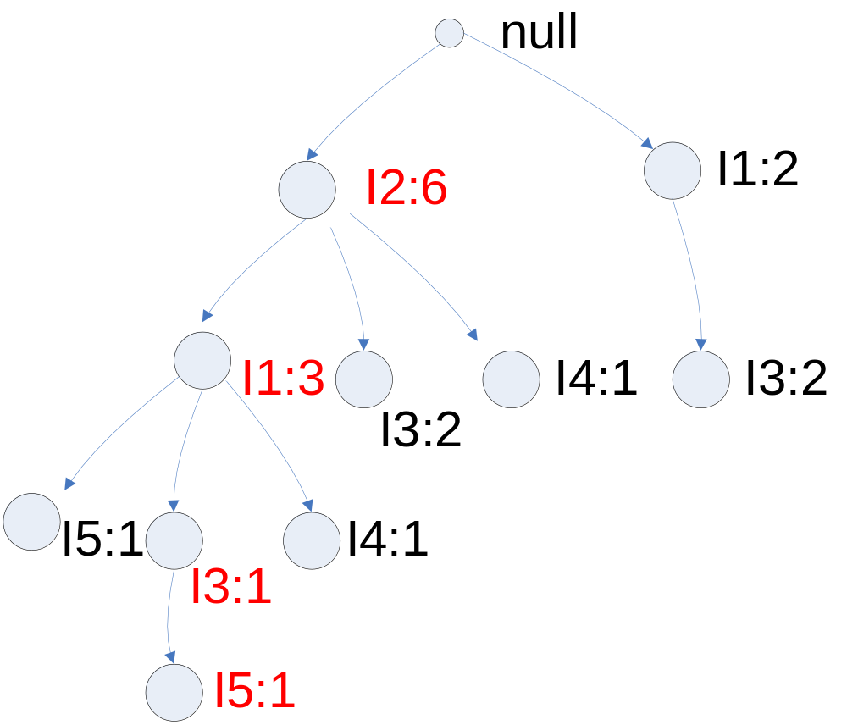
Step 9 T800=I1, I2, I3, I5

Slide 45
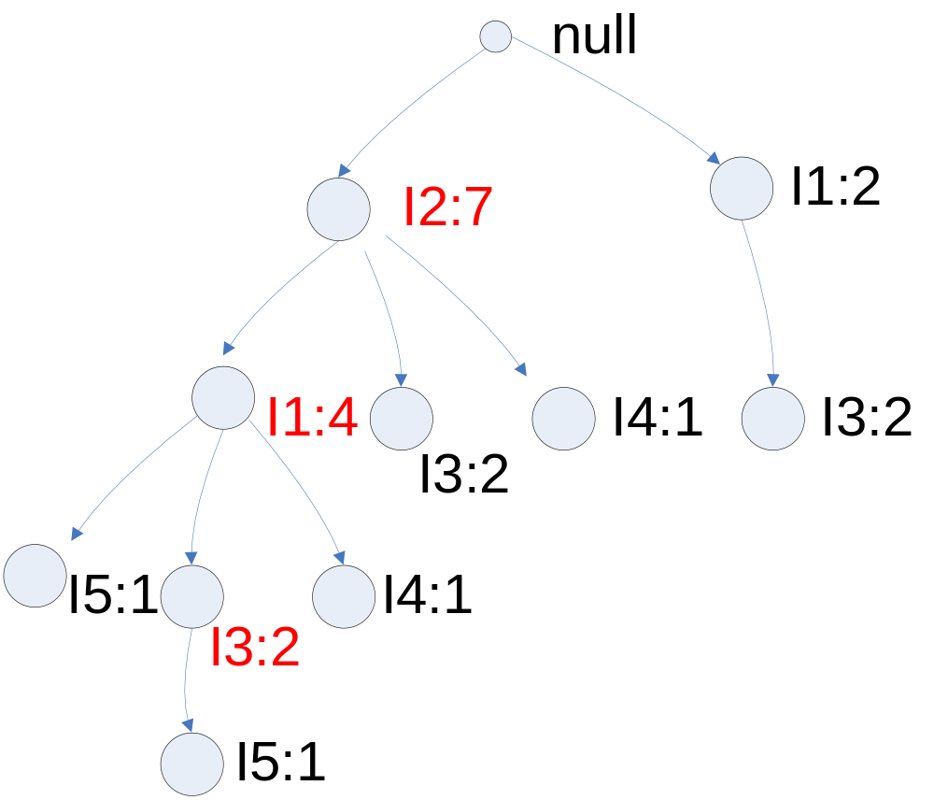
Step 10 T900=I1, I2, I3

Slide 46
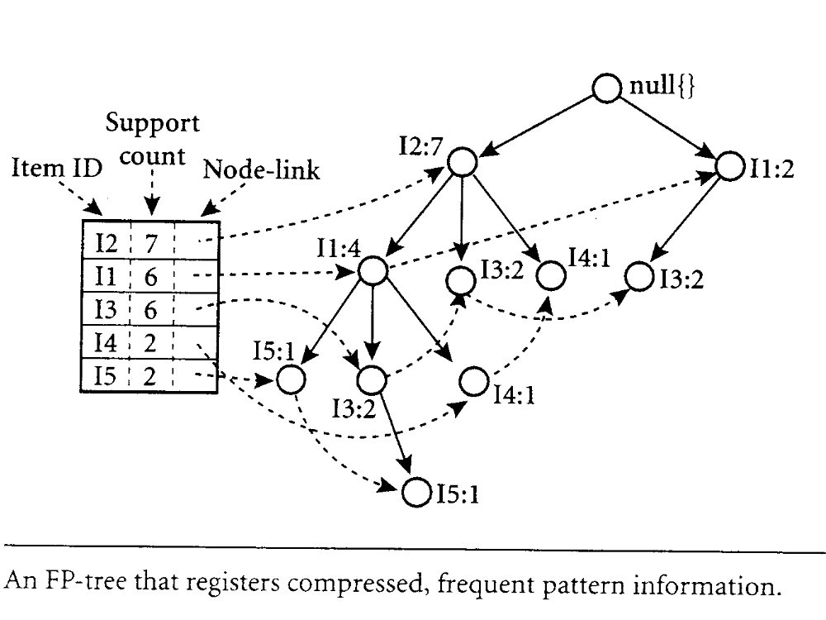
Step 11 Link table with the tree

Slide 47
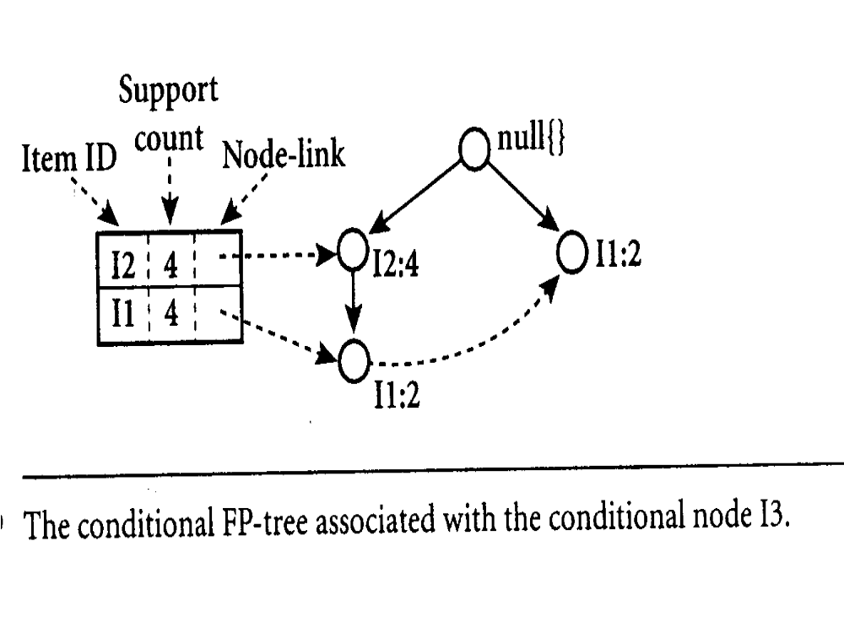

Slide 48
Reading Assignment
“Data Mining: Concepts and Techniques” by Han and Kamber, Morgan Kaufmann publishers, 2001, chapter 6, pp. 226-243.

Slide 49
Lecture Review Question 7
What is the rational of having various data mining technique? In other words, how can one decide which technique of the following to select in data mining?
Association rules
Clustering
Decision Tree
Neural network
Web Mining
Genetic programming
What are the major difference between Apriori algorithm and Frequent Pattern Tree (FP-tree) with respect to performance? Justify your answer.

Slide 50
CS5483 Tutorial Question 7
Given the weather data as shown in the table below:
CS5483 Tutorial Question 5
a) Given the weather data as shown in the table below:
Outlook | Temperature | Humidity | Windy | Play
Sunny | Hot | High | False | No
Sunny | Hot | High | True | No
Overcast | Hot | High | False | Yes
Rainy | Mild | High | False | Yes
Rainy | Cool | Normal | False | Yes
Rainy | Cool | Normal | True | No
Overcast | Cool | Normal | True | Yes
Sunny | Mild | High | False | No
Sunny | Cool | Normal | False | Yes
Rainy | Mild | Normal | False | Yes
Sunny | Mild | Normal | True | Yes
Overcast | Mild | High | True | Yes
Overcast | Hot | Normal | False | Yes
Sunny | Mild | High | True | No
In this table, there are four attributes: outlook, temperature, humidity and wind; and the outcome is whether to play or not.
(a) Show the possible Association Rules that can determine the outcome without support and confidence level.
(b) Show the Support level and Confidence level of the following association rule: If temperature = cool then humidity = normal.

